Slide 1
Reversible Logic Circuits in Quantum Cellular Automata
IETE SIVAKASI CENTRE, SIVAKASI
TechnoBlaze
A.Kamaraj
Assistant Professor (Sr.G.)
Department of ECE,
Mepco Schlenk Engineering College, Sivakasi

Slide 2

Contents
REVERSIBLE LOGIC
Invention of computing devices
Scaling of MOSFET
Emerging Logic Devices
Reversibility in Real Life
Reversible Logic
Properties
Reversibility
Universality
Fault Tolerance
Reversible Logic Circuits
QCA
Clocking
Types of wires
Examples
Router
Tools Used
Practical Feasibilities

Slide 3

Contents
REVERSIBLE LOGIC
Invention of computing devices
Scaling of MOSFET
Emerging Logic Devices
Reversibility in Real Life
Reversible Logic
Properties
Reversibility
Universality
Fault Tolerance
Reversible Logic Circuits
QCA
Clocking
Types of wires
Examples
Router
Tools Used
Practical Feasibilities

Slide 4
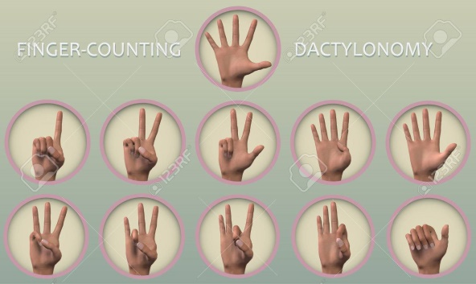
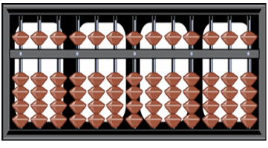
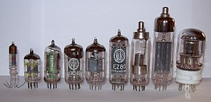
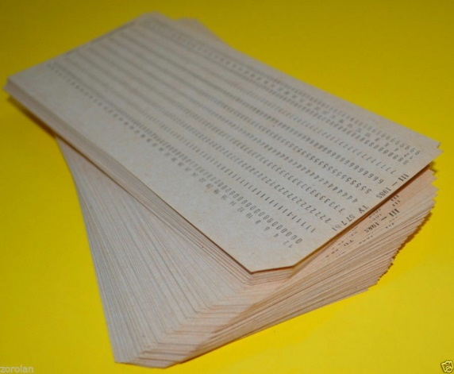
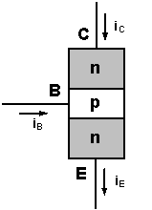
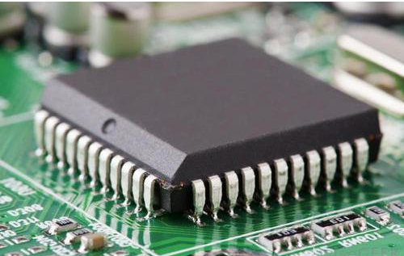
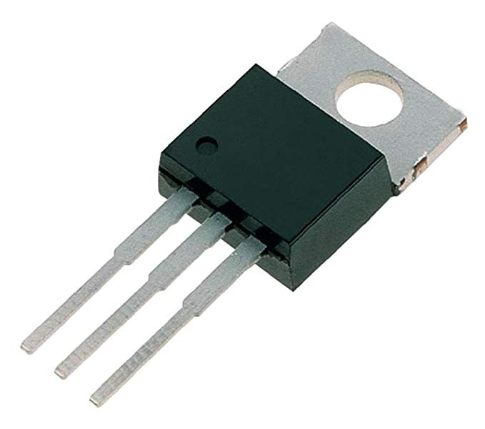
Invention of Computing Devices
Year | Invention | Remarks
Initial | Dactylonomy | Finger based computing
17th Century | Abacus, Napier’s bones, and Slide ruler | Multiplication and division
1642 | Pascal’s Calculator | Mechanical computer
1831 | Charles Babbage | Programmable Computer with Gears and Levers
19th Century | Punch card | Solves Differential Equations
1897 | Vacuum tubes | Clock frequency 5 to 10 Hz
1947 | Bipolar junction transistor | Size reduce and speed increased (in terms of kHz)
1958 | First Integrated Circuit | -
1959 | MOSFET | P and N type
1980 | CMOS | Minimum area, High Speed upto GHz and Low power dissipation
After 2020 | ????? | ????

Slide 5
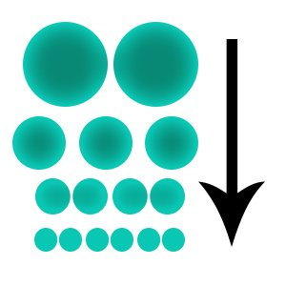
Contents
REVERSIBLE LOGIC
Invention of computing devices
Scaling of MOSFET
Emerging Logic Devices
Reversibility in Real Life
Reversible Logic
Properties
Reversibility
Universality
Fault Tolerance
Reversible Logic Circuits
QCA
Clocking
Types of wires
Examples
Router
Tools Used
Practical Feasibilities

Slide 6
Scaling of MOSFET
Year | Scaling of MOSFET
1971 | 10 µm
1974 | 6 µm
1977 | 3 µm
1982 | 1.5 µm
1985 | 1 µm
1989 | 800 nm
1994 | 600 nm
1995 | 350 nm
1997 | 250 nm
1999 | 180 nm
2001 | 130 nm
2004 | 90 nm
2006 | 65 nm
2008 | 45 nm
2010 | 32 nm
2012 | 22 nm
2014 | 14 nm
2017 | 10 nm
2018 | 7 nm
~2020 | 5 nm

Slide 7
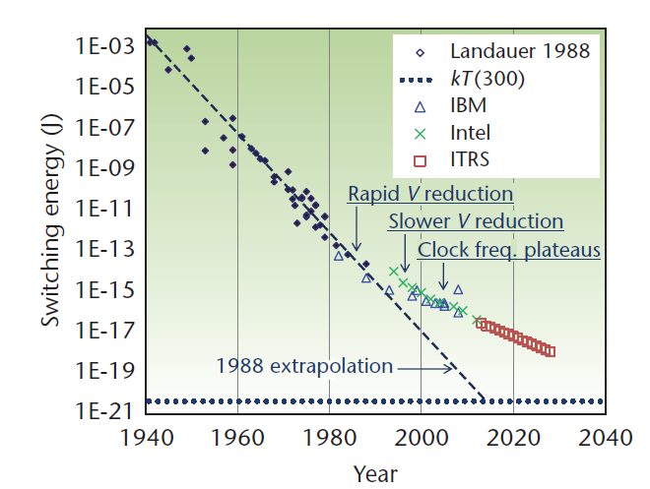
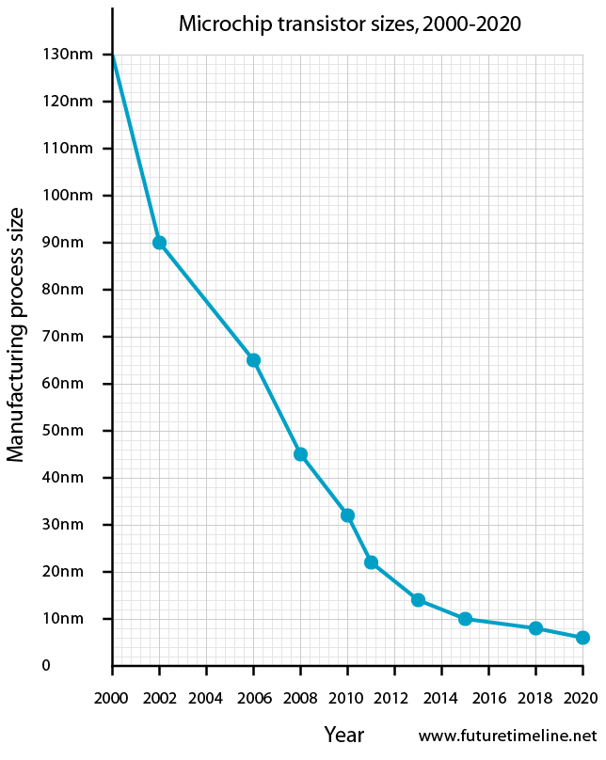
Source: Intel transistors on microprocessors: Microprocessor Quick Reference Guide, Intel Research,
http://www.intel.com/pressroom/kits/quickrefyr.htm
Physical Constraints
Miniaturization (A)
Minimum channel width (L) devices = greater than kT.
Gate insulator thickness (T_{Ox}) and
Operating voltage (V_{DD}) could no longer be simply reduced along with other device dimensions.
Solution
3D integration
New Devices

Slide 8
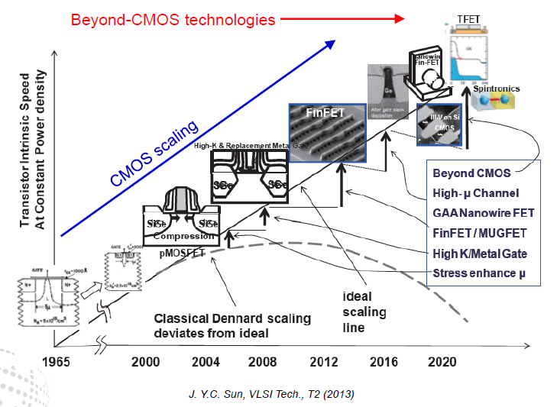
Technology Innovations Driven by Scaling

Slide 9
Contents
REVERSIBLE LOGIC
Invention of computing devices
Scaling of MOSFET
Emerging Logic Devices
Reversibility in Real Life
Reversible Logic?
Properties
Reversibility
Universality
Fault Tolerance
Reversible Logic Circuits
QCA
Clocking
Types of wires
Examples
Router
Tools Used
Practical Feasibilities

Slide 10
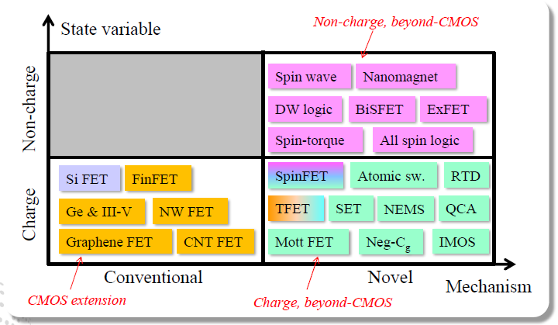
Emerging Logic Devices
The amount of energy dissipation is KTln2 per bit erase.

Slide 11
Contents
REVERSIBLE LOGIC
Invention of computing devices
Scaling of MOSFET
Emerging Logic Devices
Reversibility in Real Life
Reversible Logic
Properties
Reversibility
Universality
Fault Tolerance
Reversible Logic Circuits
QCA
Clocking
Types of wires
Examples
Router
Tools Used
Practical Feasibilities

Slide 12
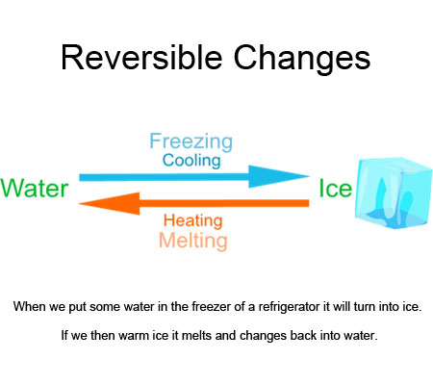


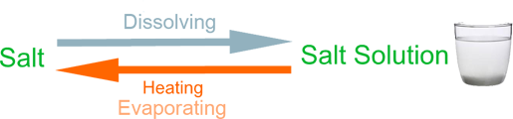
Reversibility in Real Life

Slide 13
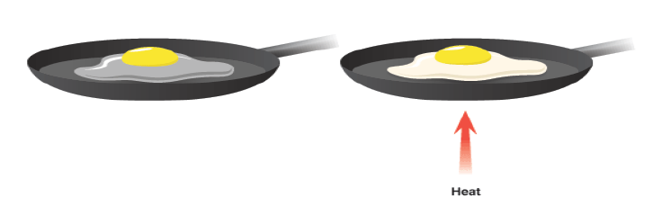
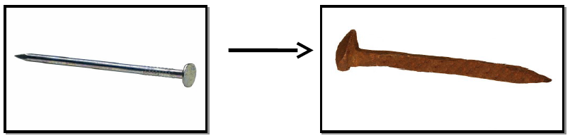
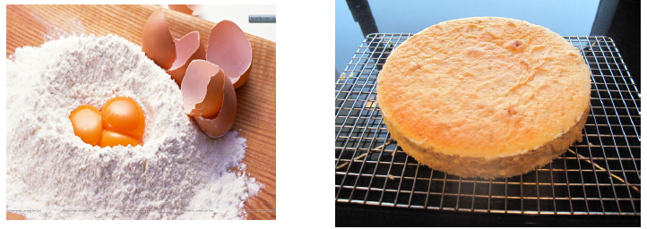

Irreversibility

Slide 14

Contents
REVERSIBLE LOGIC
Invention of computing devices
Scaling of MOSFET
Emerging Logic Devices
Reversibility in Real Life
Reversible Logic
Properties
Reversibility
Universality
Fault Tolerance
Reversible Logic Circuits
QCA
Clocking
Types of wires
Examples
Router
Tools Used
Practical Feasibilities

Slide 15
Why Reversible Logic?
It has been proved ( by Bennett and Landauer) that ,
“losing information in a circuit causes losing power. Information lost when the input vector cannot be uniquely recovered from the output vector of a combinational circuit”.
The gate/ circuit does not loose information is called Reversible.
kT * log 2 Joules of heat energy for every bit of information that is lost.

Slide 16
KTln2
KTln2
KTln2
KTln2
KTln2
KTln2
KTln2
KTln2
KTln2
KTln2
KTln2
KTln2
KTln2
KTln2
KTln2
KTln2
KTln2
KTln2
KTln2
KTln2
KTln2
KTln2
KTln2
KTln2
KTln2
KTln2
KTln2
KTln2
KTln2
KTln2
KTln2
KTln2
KTln2
KTln2
KTln2
KTln2
KTln2
KTln2
KTln2
KTln2
KTln2
KTln2
KTln2
KTln2
KTln2
KTln2
KTln2
KTln2
KTln2
KTln2
KTln2
KTln2
KTln2
KTln2
KTln2
KTln2
The amount of energy dissipation is KTln2 per bit erase.
INFORMATION LOSS = = = ENERGY LOSS

Slide 17
What is Reversible Logic?
A gate or a circuit is reversible if the mapping from the inputs to the outputs is bijective.
Number of inputs is equal to number of outputs; have one-to-one mapping.
Minimum number of garbage outputs.
i
O
1
1
i
O
2
2
i
O
3
Reversible
Gate
3
i
O
K-1
K-1
i
O
K
K

Slide 18
Difference Between Reversible Gate and Irreversible Gate
Conventional gate dissipates energy because it discards information.
Reversible gates does not dissipate energy because there is no information erasure.
A
A
A
A
B
B
B
B
0
A&B
0
A&B

Slide 19
Contents
REVERSIBLE LOGIC
Invention of computing devices
Scaling of MOSFET
Emerging Logic Devices
Reversibility in Real Life
Reversible Logic
Properties
Reversibility
Universality
Fault Tolerance
Reversible Logic Circuits
QCA
Clocking
Types of wires
Examples
Router
Tools Used
Practical Feasibilities

Slide 20
Reversibility
For any deterministic device to be reversible is that its input and output be uniquely retrievable from each other - then it is called logically reversible.

Slide 21
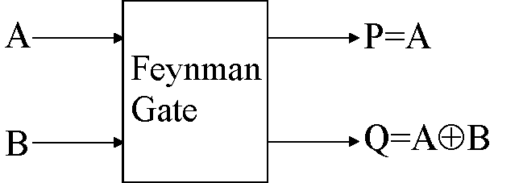
Feynman Gate
The input vector is I (A, B) and the output vector is O (P, Q).
The outputs are defined by P=A, Q=A B.
Quantum cost of a Feynman gate is 1.
A | B | P | Q
0 | 0 | 0 | 0
0 | 1 | 0 | 1
1 | 0 | 1 | 1
1 | 1 | 1 | 0

Slide 22
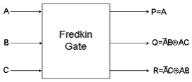
Fredkin Gate
The Fredkin gate swaps the last two bits, if the first bit is set.
Quantum cost of a Fredkin gate is 5.
A | B | C | P | Q | R
0 | 0 | 0 | 0 | 0 | 0
0 | 0 | 1 | 0 | 0 | 1
0 | 1 | 0 | 0 | 1 | 0
0 | 1 | 1 | 0 | 1 | 1
1 | 0 | 0 | 1 | 0 | 0
1 | 0 | 1 | 1 | 1 | 0
1 | 1 | 0 | 1 | 0 | 1
1 | 1 | 1 | 1 | 1 | 1

Slide 23
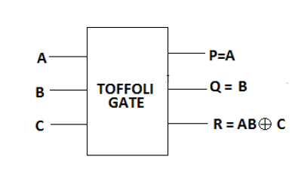
Toffoli Gate
If we want to compute an arbitrary function using reversible gates, we need another gate. One possibility is the Toffoli gate.
INPUT |  |  | OUTPUT
0 | 0 | 0 | 0 | 0 | 0
0 | 0 | 1 | 0 | 0 | 1
0 | 1 | 0 | 0 | 1 | 0
0 | 1 | 1 | 0 | 1 | 1
1 | 0 | 0 | 1 | 0 | 0
1 | 0 | 1 | 1 | 0 | 1
1 | 1 | 0 | 1 | 1 | 1
1 | 1 | 1 | 1 | 1 | 0

Slide 24
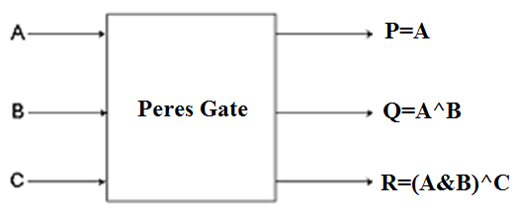
Peres Gate
Used as a half-adder, when third input is 0.
A | B | C | P | Q | R
0 | 0 | 0 | 0 | 0 | 0
0 | 0 | 1 | 0 | 0 | 1
0 | 1 | 0 | 0 | 1 | 0
0 | 1 | 1 | 0 | 1 | 1
1 | 0 | 0 | 1 | 1 | 0
1 | 0 | 1 | 1 | 1 | 1
1 | 1 | 0 | 1 | 0 | 1
1 | 1 | 1 | 1 | 0 | 0

Slide 25
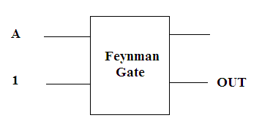
Reversible Logic Functions
Reversible NOT gate

Slide 26
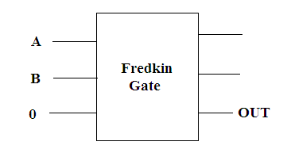
Reversible Logic Functions
Reversible AND gate

Slide 27
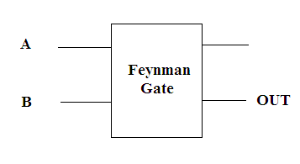
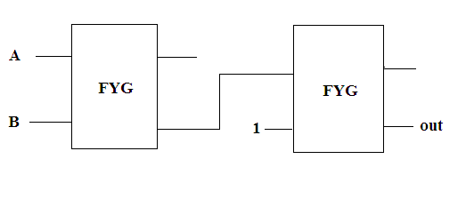
Reversible Logic Functions
Reversible XOR gate
Reversible XNOR gate

Slide 28
Contents
REVERSIBLE LOGIC
Invention of computing devices
Scaling of MOSFET
Emerging Logic Devices
Reversibility in Real Life
Reversible Logic
Properties
Reversibility
Universality
Fault Tolerance
Reversible Logic Circuits
QCA
Clocking
Types of wires
Examples
Router
Tools Used
Practical Feasibilities

Slide 29
Universality
Universality of the Fredkin gate is verified by construction to demonstrate how the gate can be used to realize the
AND / NAND,
OR / NOR,
NOT.

Slide 30
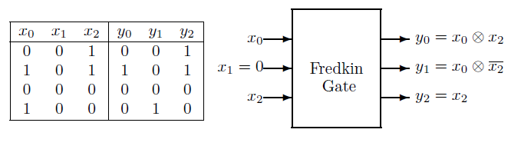
AND operation
x₁ input to 0, y₀ = x₀ ⊗x₂

Slide 31
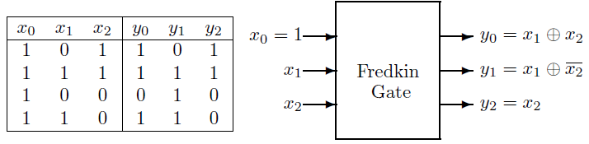
OR Operation
x₀ input to 1, y₀ = x₁ ⊕x₂

Slide 32
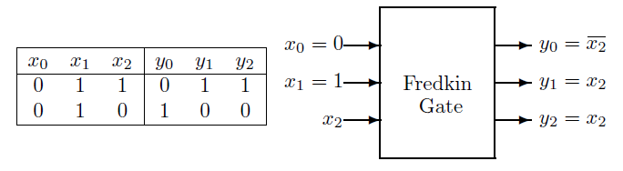
NOT operation
x₀ input to 0 and the
x₁ input to 1, and using x₂ as the input bit

Slide 33
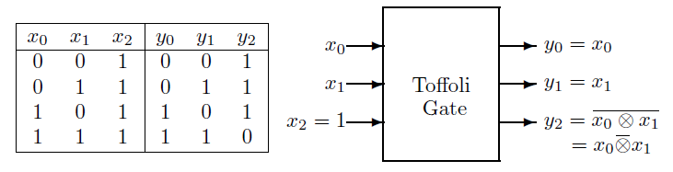
Toffoli - Universality
2-bit NAND gate
Set X₂ at 1, the output bit Y₂ gives NAND on inputs X₀ and X_{1.}

Slide 34
Contents
REVERSIBLE LOGIC
Invention of computing devices
Scaling of MOSFET
Emerging Logic Devices
Reversibility in Real Life
Reversible Logic
Properties
Reversibility
Universality
Fault Tolerance
Reversible Logic Circuits
QCA
Clocking
Types of wires
Examples
Router
Tools Used
Practical Feasibilities

Slide 35
Fault Tolerance
A gate is parity preserving.

Slide 36
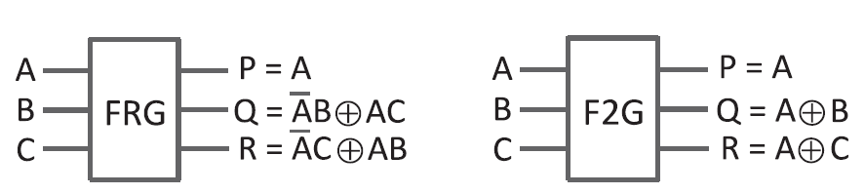
FT Gates
A | B | C | P | Q | R | FT
0 | 0 | 0 | 0 | 0 | 0 | 0
0 | 0 | 1 | 0 | 0 | 1 | 1
0 | 1 | 0 | 0 | 1 | 0 | 1
0 | 1 | 1 | 0 | 1 | 1 | 0
1 | 0 | 0 | 1 | 0 | 0 | 1
1 | 0 | 1 | 1 | 1 | 0 | 0
1 | 1 | 0 | 1 | 0 | 1 | 0
1 | 1 | 1 | 1 | 1 | 1 | 1
A | B | C | P | Q | R | FT
0 | 0 | 0 | 0 | 0 | 0 | 0
0 | 0 | 1 | 0 | 0 | 1 | 1
0 | 1 | 0 | 0 | 1 | 0 | 1
0 | 1 | 1 | 0 | 1 | 1 | 0
1 | 0 | 0 | 1 | 1 | 1 | 1
1 | 0 | 1 | 1 | 1 | 0 | 0
1 | 1 | 0 | 1 | 0 | 1 | 0
1 | 1 | 1 | 1 | 0 | 0 | 1

Slide 37
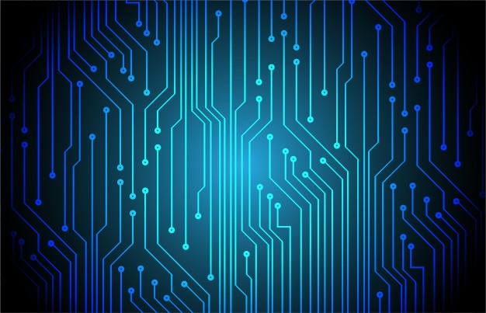
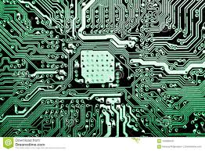
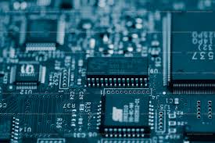
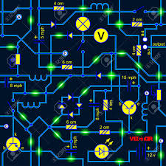
Contents
REVERSIBLE LOGIC
Invention of computing devices
Scaling of MOSFET
Emerging Logic Devices
Reversibility in Real Life
Reversible Logic
Properties
Reversibility
Universality
Fault Tolerance
Reversible Logic Circuits
QCA
Clocking
Types of wires
Examples
Router
Tools Used
Practical Feasibilities

Slide 38
Reversible Full Adder/Subtractor

Slide 39
8-bit Reversible Adder/Subtractor

Slide 40
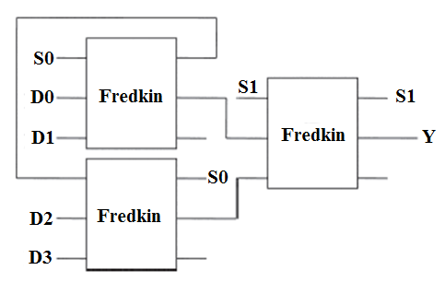
4 to 1 Reversible Multiplexer

Slide 41
Research Works Done So far in this field…
Combinational logic circuits:
Full Adder/Subtractor,
Encoder and Decoder,
Comparator
Sequential circuits:
Latch (D-latch, JK latch, T-latch)
Flip-flops (D-flipflop, JK flipflop, T-flipflop, SR)
Barrel shifter
Shift registers (SIPO, SISO, PISO, PIPO)

Slide 42
Contents
REVERSIBLE LOGIC
Invention of computing devices
Scaling of MOSFET
Emerging Logic Devices
Reversibility in Real Life
Reversible Logic
Properties
Reversibility
Universality
Fault Tolerance
Reversible Logic Circuits
QCA
Clocking
Types of wires
Examples
Router
Tools Used
Practical Feasibilities

Slide 43
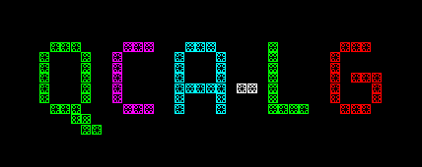

Slide 44
Quantum Cellular Automata (QCA)
A QCA cell is a coupled dot system in which four dots are at the vertices of a square. The cell has two extra electrons that occupy the diagonals within the cell due to electrostatic repulsion.
The cell polarization P measures the charge distribution along diagonal axes and is given by equation 1 (here Pi denotes the electronic charge at dot i).

Slide 45
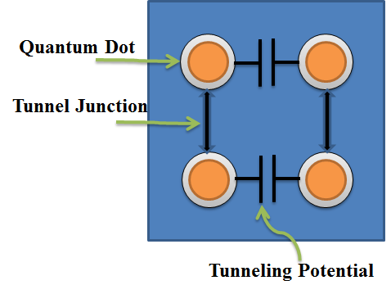
Quantum Dot

Slide 46
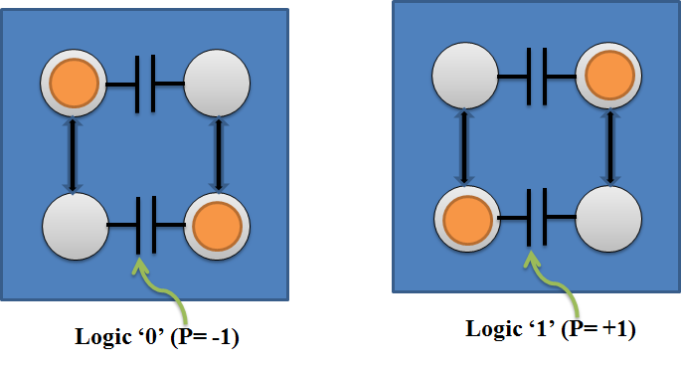
Logical Value of Quantum Dot

Slide 47
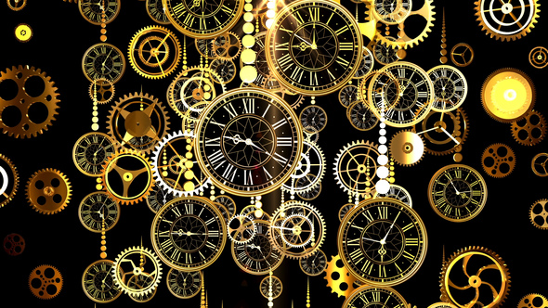
Contents
REVERSIBLE LOGIC
Invention of computing devices
Scaling of MOSFET
Emerging Logic Devices
Reversibility in Real Life
Reversible Logic
Properties
Reversibility
Universality
Fault Tolerance
Reversible Logic Circuits
QCA
Clocking
Types of wires
Examples
Router
Tools Used
Practical Feasibilities

Slide 48
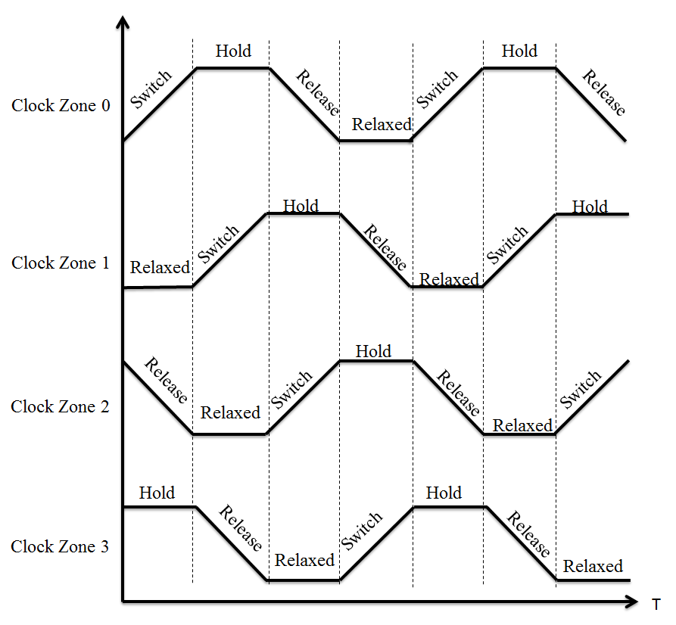
QCA Clocking

Slide 49
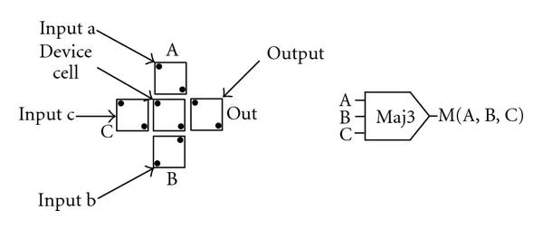
Majority Voter Gate

Slide 50
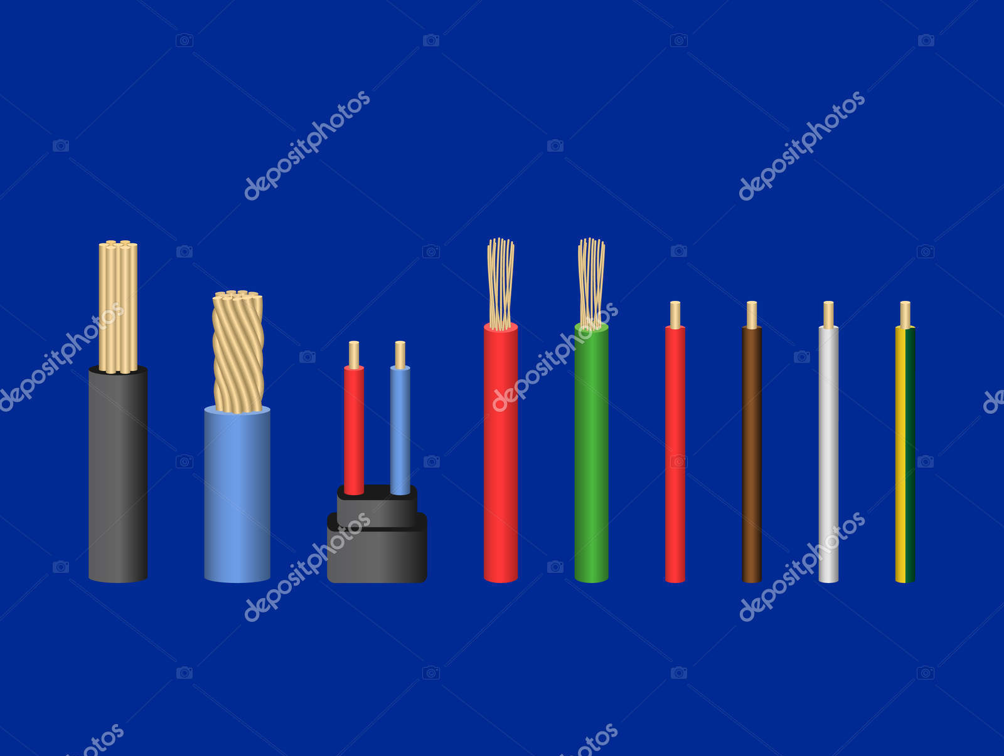
Contents
REVERSIBLE LOGIC
Invention of computing devices
Scaling of MOSFET
Emerging Logic Devices
Reversibility in Real Life
Reversible Logic
Properties
Reversibility
Universality
Fault Tolerance
Reversible Logic Circuits
QCA
Clocking
Types of wires
Examples
Router
Tools Used
Practical Feasibilities

Slide 51
Types of wires in QCA
a) Binary Wire
b)Inverter Chain

Slide 52
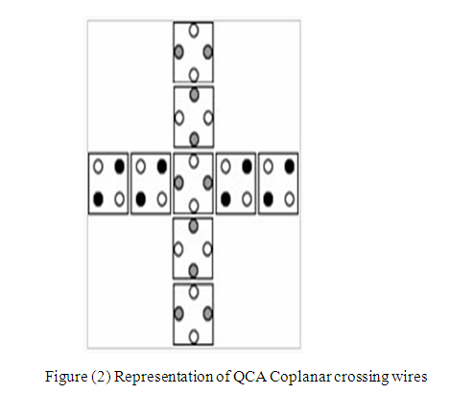
Coplanar Wire Crossing
Junction
Wire 1
Wire 2
Figure (1) Two Coplanar Crossing Wires

Slide 53
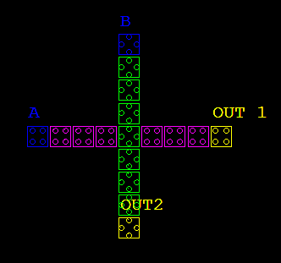
Coplanar Crossing

Slide 54
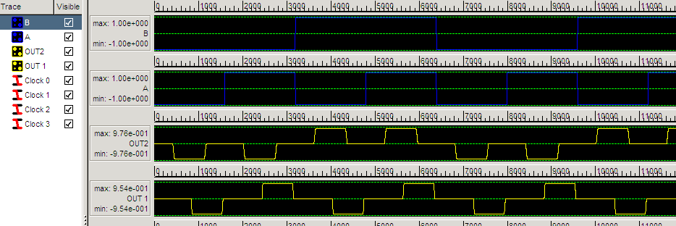
Coplanar Wire Crossing - Simulation

Slide 55
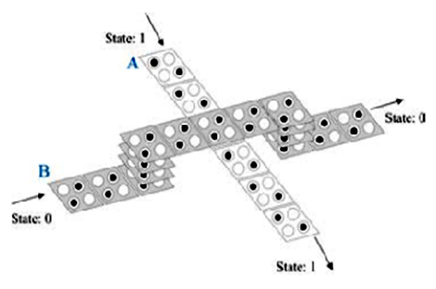
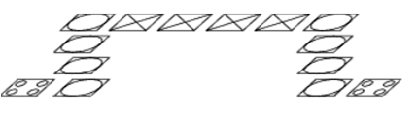
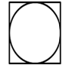
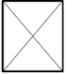
Multilayer Crossing
Normal Cell
Via
Crossover

Slide 56
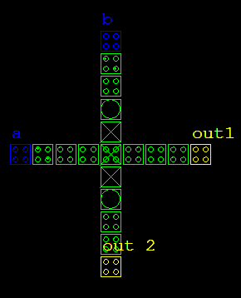
Multilayer Crossing

Slide 57

Multilayer Crossing -Simulation

Slide 58

Contents
REVERSIBLE LOGIC
Invention of computing devices
Scaling of MOSFET
Emerging Logic Devices
Reversibility in Real Life
Reversible Logic
Properties
Reversibility
Universality
Fault Tolerance
Reversible Logic Circuits
QCA
Clocking
Types of wires
Examples
Router
Tools Used
Practical Feasibilities

Slide 59
COPLANAR CROSSINGS

Slide 60

FEYNMAN GATE

Slide 61

FREDKIN GATE

Slide 62
MULTILATER CROSSING

Slide 63

FREDKIN GATE

Slide 64

FEYNMAN GATE

Slide 65
Coplanar vs Multilayer
 | Feynman gate |  | Fredkin gate |  | Toffoli gate |  | Peres gate
Parameters | Coplanar crossing | Multilayer crossing | Coplanar crossing | Multilayer crossing | Coplanar crossing | Multilayer crossing | Coplanar crossing | Multilayer crossing
No. of cells | 122 | 77 | 392 | 133 | 131 | 90 | 310 | 194
Area-nm² | 39528 | 24948 | 127008 | 43092 | 42444 | 29160 | 100440 | 62856
Simulation time | 34s | 27s | 96s | 45s | 45s | 35s | 87s | 65s

Slide 66

Full Adder

Slide 67

Contents
REVERSIBLE LOGIC
Invention of computing devices
Scaling of MOSFET
Emerging Logic Devices
Reversibility in Real Life
Reversible Logic
Properties
Reversibility
Universality
Fault Tolerance
Reversible Logic Circuits
QCA
Clocking
Types of wires
Examples
Router
Tools Used
Practical Feasibilities

Slide 68

Reversible Router
Components of the Router | Specification
Decoder | 2 to 4
Memory Array | 4 × 4
Multiplexer | 4 × 1
Demultiplexer | 1 × 4
Parallel to serial Converter | 4 × 1
Switch Fabric | 4 × 4

Slide 69

Memory Cell

Slide 70

Complete Router Architecture

Slide 71

Memory Cell
AND
R/W
2 X1
MUX
INPUT
ROW SELECT
LOGIC 0

Slide 72

Memory Cell – Simulation Output
ROW SELECT
1
1
READ
1
1
1
1
1
1
INPUT
0
0
0
0
0
0
0
0
1
1
1

Slide 73

Memory Array
DECODER
2:4
INPUT
MEMORY CELL
READ LINE
MUTI LAYER

Slide 74

Complete Router Architecture

Slide 75
Resource Utilization of Router Components
Parameters | Demux | P to S converter | Router | Decoder | Mux | Memory | Complete Router
Complexity | 22 cells | 41 cells | 3057 cells | 188 cells | 277 cells | 7465 cells | 10932 cells
Simulation time | 4s | 4s | 25s | 4 | 5 | 75s | 128s
Area (µm²) | 212400 | 50150 | 7910900 | 203500 | 448500 | 16747500 | 30394500
Latency | 1s | 4s | 6s | 3s | 5s | 20s | 44s
Layers | 3 | 1 | 3 | 3 | 3 | 3 | 3

Slide 76
Comparison of Existing and Proposed Router
Parameters | Router Existing Design | Router Proposed Design | Percentage of Improvement
Complexity | 4026 | 3057 cells | 24 %
Latency | 48 | 24 | 50 %
Area (µm²) | 13.81 | 7.91 | 42.7 %
Simulation time | NA | 25s | -
Layers | 3 | 3 | Same

Slide 77

Contents
REVERSIBLE LOGIC
Invention of computing devices
Scaling of MOSFET
Emerging Logic Devices
Reversibility in Real Life
Reversible Logic
Properties
Reversibility
Universality
Fault Tolerance
Reversible Logic Circuits
QCA
Clocking
Types of wires
Examples
Router
Tools Used
Practical Feasibilities

Slide 78
Tools Used
QCADesigner 2.0.3
RCViewer+
RevLib (Unix Based)
QCAPro (Licenced )

Slide 79
Contents
REVERSIBLE LOGIC
Invention of computing devices
Scaling of MOSFET
Emerging Logic Devices
Reversibility in Real Life
Reversible Logic
Properties
Reversibility
Universality
Fault Tolerance
Reversible Logic Circuits
QCA
Clocking
Types of wires
Examples
Router
Tools Used
Practical Feasibilities

Slide 80


Practical Feasibilities
https://www.dwavesys.com/software
https://eandt.theiet.org/content/articles/2019/04/how-quantum-computers-are-transforming-travel/
https://www.quantumrun.com/prediction/how-quantum-computers-will-change-world-future-computers
‘With quantum computing, you can optimise air traffic routes, not just one route at a time, but all routes in one go’
- Grazia Vittadini, Airbus

Slide 81


